Slide 1
Project
House Price prediction using Data Mining
Group members: Mahsa Rahimian Rumana sultana Course Name: data mining Instructor: DR. Farnoush Banaei-kashani The University of Colorado Denver
Github Link: https://github.com/RumanaCU/House-Price-Prediction

Slide 2
Outline
Problem statement
Methods
Tools
Results
Lessons learned
References

Slide 3

Problem statement
Our goal in this project is to predict efficient house pricing for investors based on their priorities and budgets.
In this paper, we will use different data mining strategies and linear regression algorithms to predict prices by analyzing current house prices, and then predict the future prices.

Slide 4
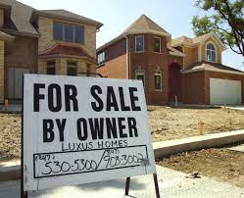
Problem statement
This project can impact anybody who is looking for house, real estate’s companies, and those who wants to invest on proper properties.

Slide 5
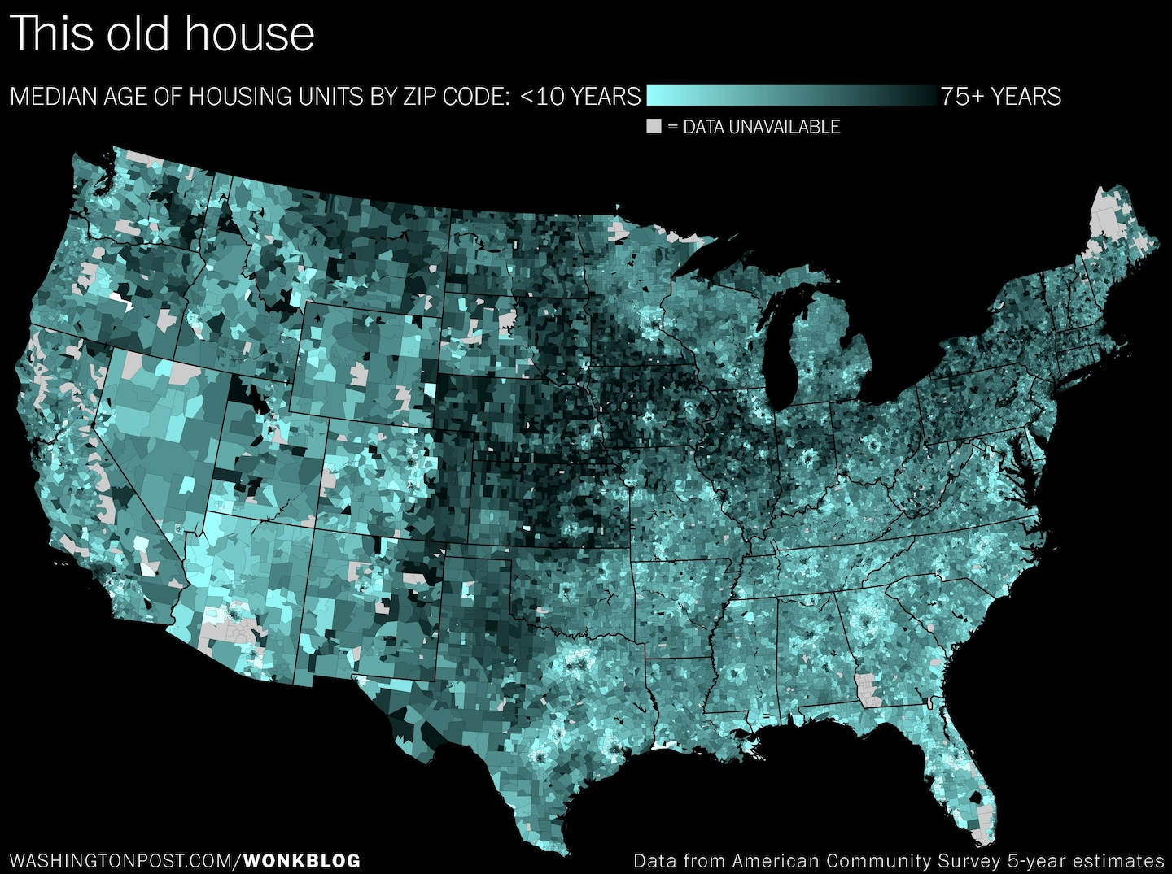
Data set and data processing
In this project the first step that we are performing i data preprocessing. the dataset for this project has been obtained from Zillow.com. We used Zillow Home Value Index (ZHVI) [1] dataset that is a smoothed, seasonally adjusted measure of the typical home value and market changes across a given region and housing type. It reflects the typical value for homes in the 35th to 65th percentile range.The dataset has different type of time series housing price data per month from january 2000 to October 2021.

Slide 6

Data Analysis
In this step we can discover the implicit patterns of the data, which in turn helps choose appropriate machine learning approaches.

Slide 7

Model Selection
Before building models, the data should be processed accordingly so that the models could learn the patterns more
efficiently.

Slide 8
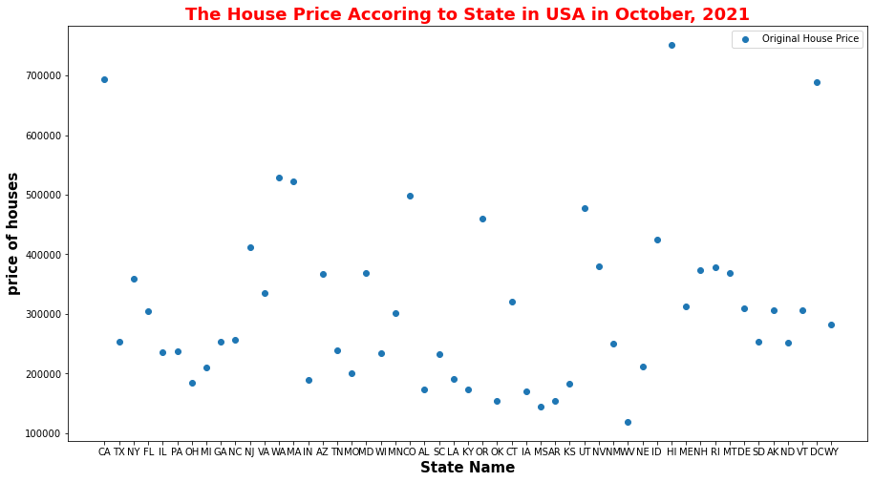
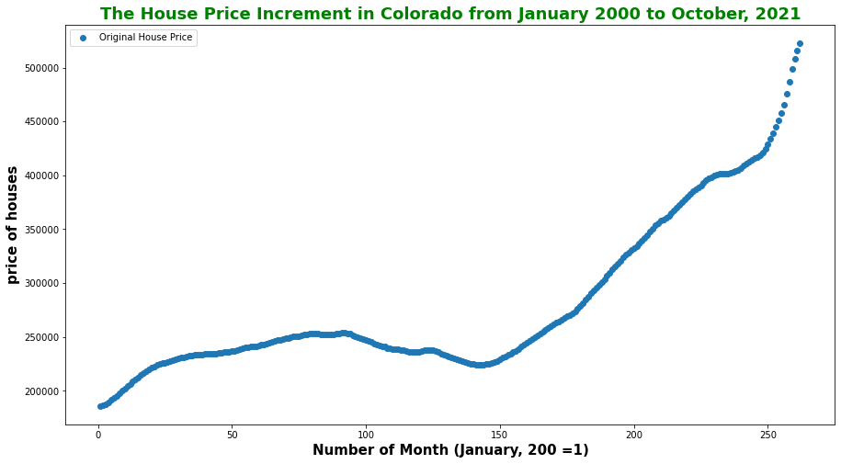
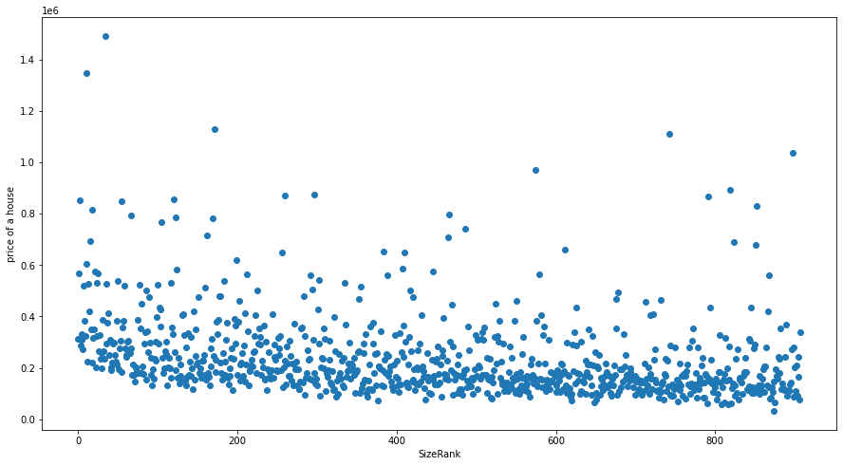
Methods Some Data Visualization
Figure 2: Statewide plot of house price on October, 2021
Figure 1: Increment in house price in Colorado from January 2000 to now
Metro-based Data set form Zillow
Taking Average Price of all months
Figure 3: Scatter plot of house price based on Metro

Slide 9
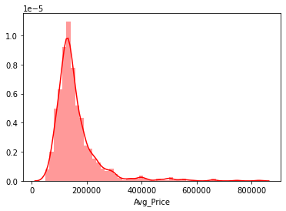
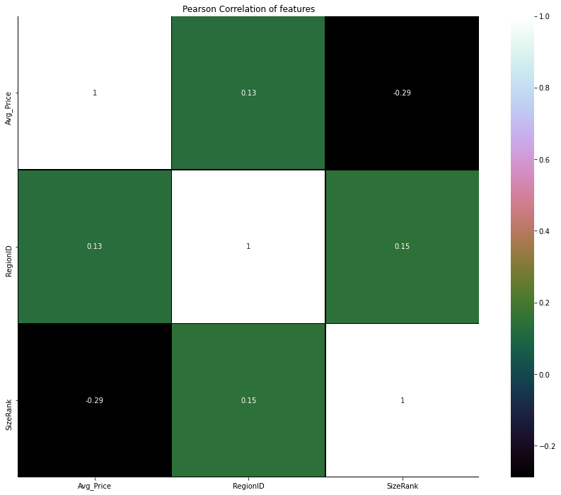
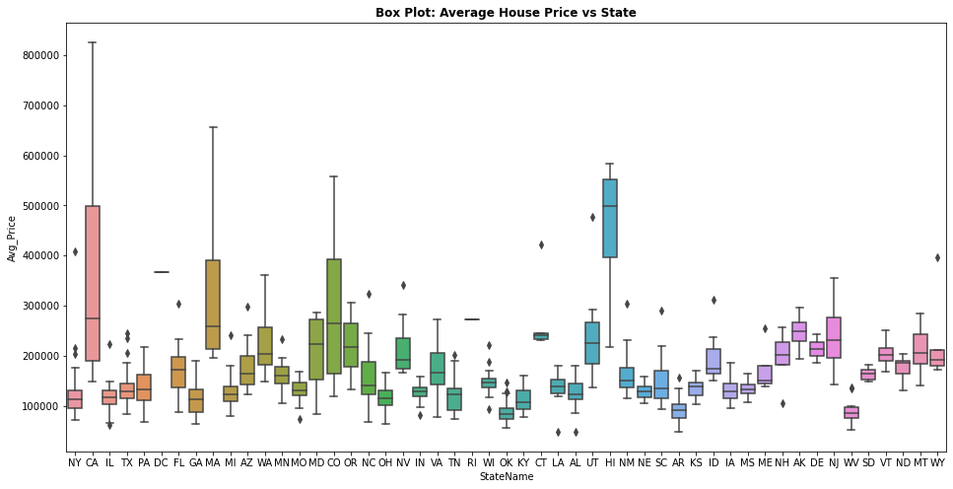
Methods Some Data Visualizations
Metro-based Data set form Zillow
Taking Average Price of all months
Figure 5: Distribution plot on average price in Metro data
Figure 6: Box plot of average house price of metropolitan data (Statewise)
Figure 4: Pearson Correlation between features with average price (Metro)

Slide 10
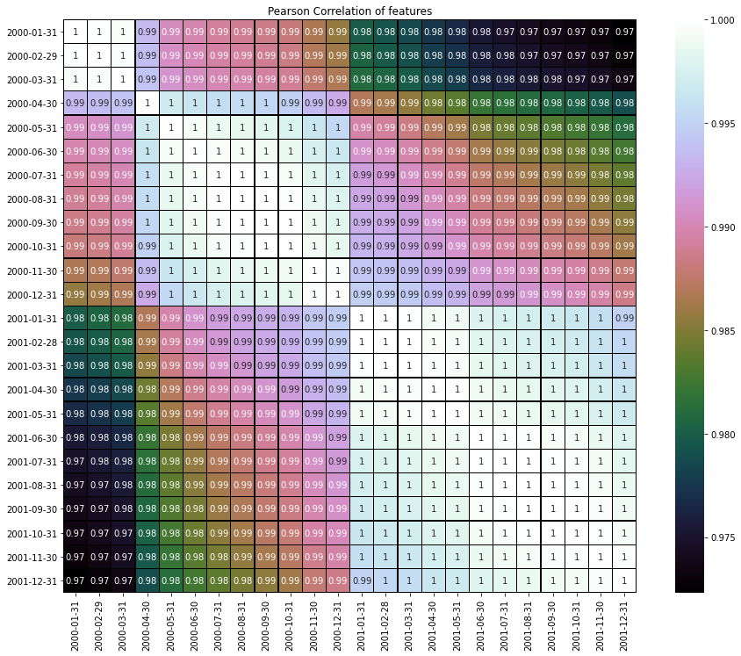
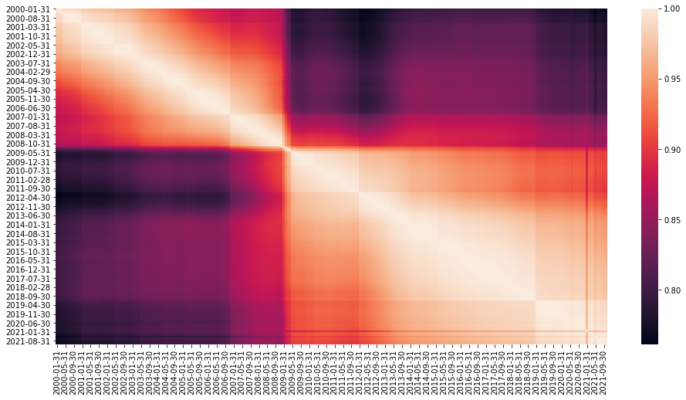
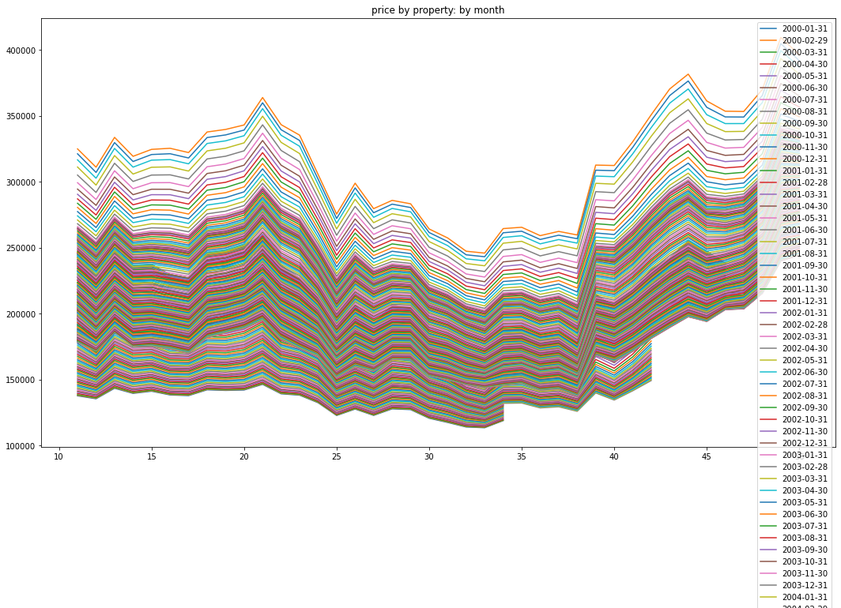
Methods Data preparation
Figure 8: The last 24 months house prices correlation
Figure 7: Correlation between all months from 2000 to 2021
Figure 9: All months’ price plot after data preparation (State based)
Metro-based dataset form Zillow
Taking prices of all months

Slide 11
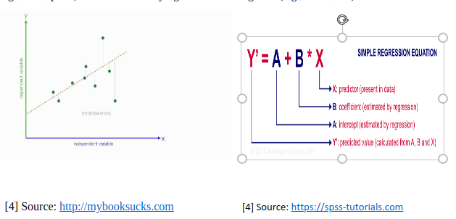
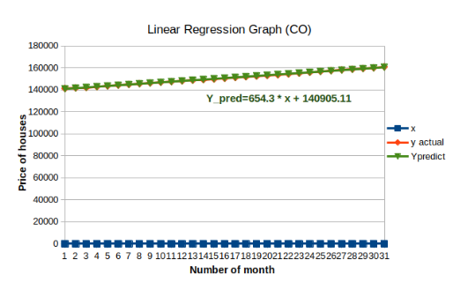
Methods Model Development
Figure 10: Linear regression model
Algorithm:
Calculate x_mean and y_mean.
Calculate the difference between (x[i], x_mean) and (y[i],y_mean)
Calculate the square of the difference between (x[i], x_mean)
and sum
Calculate the products of the difference between (x[i], x_mean) and (y[i],y_mean) and sum
Calculate the coefficient, B by the equation B =(diffx * diffy)/(diffx *diffx)
Calculate the intercept A by the equation A=y_mean- (B* x_mean)
Finally calculate the prediction by the equation: Y_pred=B*x+A and draw the regression line.
Figure 11: Graph of preliminary hand calculation analysis
Figure 7: Correlation between all months from 2000 to 2021

Slide 12
tools
MATplotlib has user-friendly plotting toolbox for data visualizations
Python3 with Jupyter Notebook is very enriched with machine and deep learning libraries.
NumPy makes easy complex machine and deep learning numerical operations with large dataset.
SciPy contains different modules for optimization, linear algebra, integration and statistics that is very helpful for data analysis.
Scikit-learn, a machine learning library for Python has various algorithms like support vector machine, random forests, and k-neighbors, and it supports Python numerical and scientific libraries like NumPy and SciPy.

Slide 13
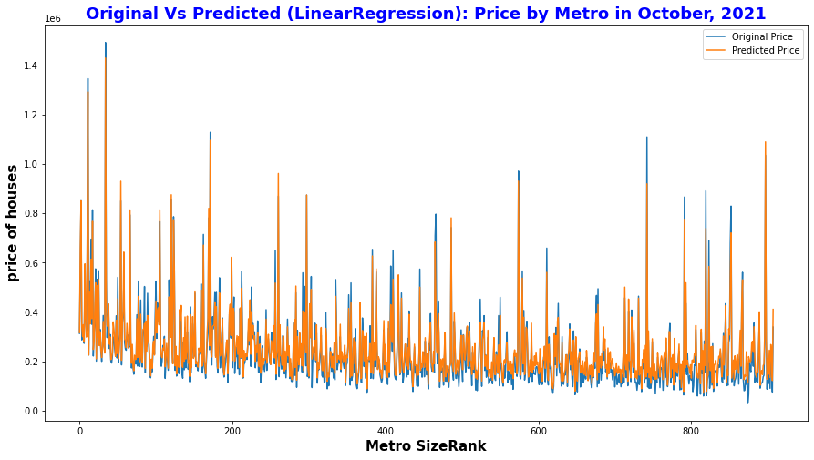
Results (Training)
Figure 12: Original vs. Predicted result on Metro-based data Linear regression model

Slide 14
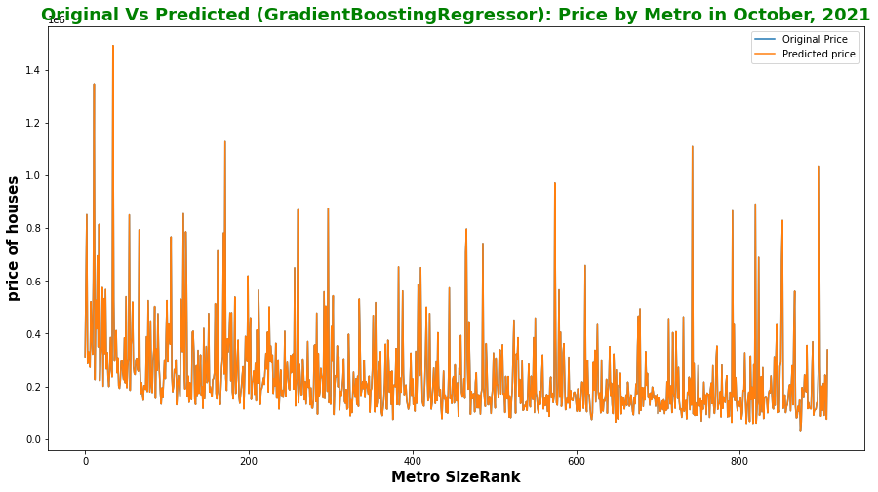
Results (Training)
Figure 13: Original vs. Predicted result GradientBoostingregression on metro-based data

Slide 15
Results (Training)
Table : Most and Less expensive house price
Most Expensive |  | Less Expensive
Predicted | Original |  | Predicted | Original
1493019.88 | 1493020.00 |  | 31775.00 | 31775.00
1346994.95 | 1346995.00 |  | 58553.00 | 58553.00
1128825.92 | 1128826.00 |  | 58558.00 | 58558.00
1110212.99 | 1110213.00 |  | 59964.00 | 59964.00
1035467.98 | 1035468.00 |  | 62956.99 | 62957.00

Slide 16
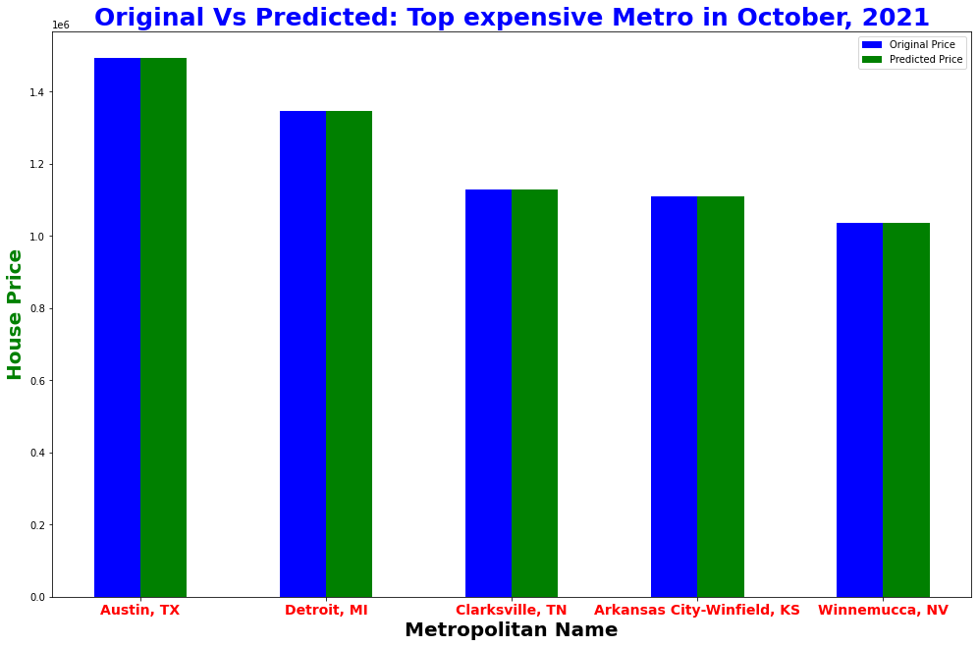
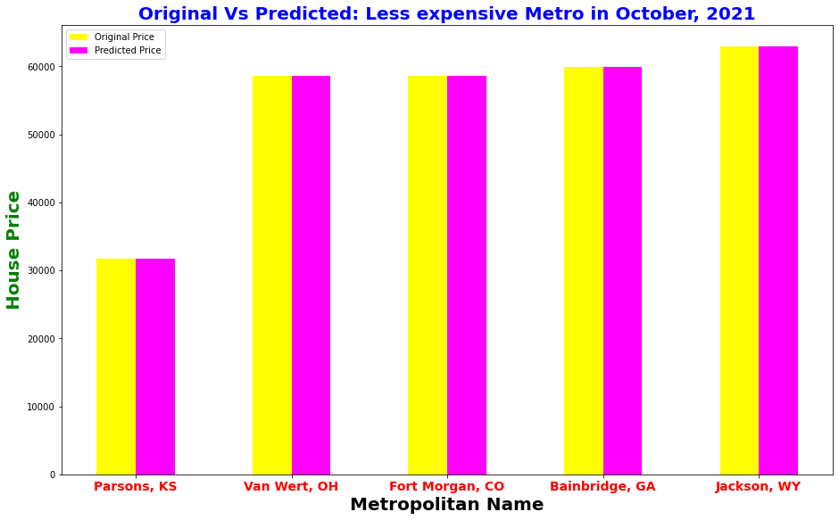
Results (Training)
Figure 14: Most expensive metropolitan (predicted vs. original)
Figure 15: Less expensive metropolitan name (predicted vs. original)

Slide 17
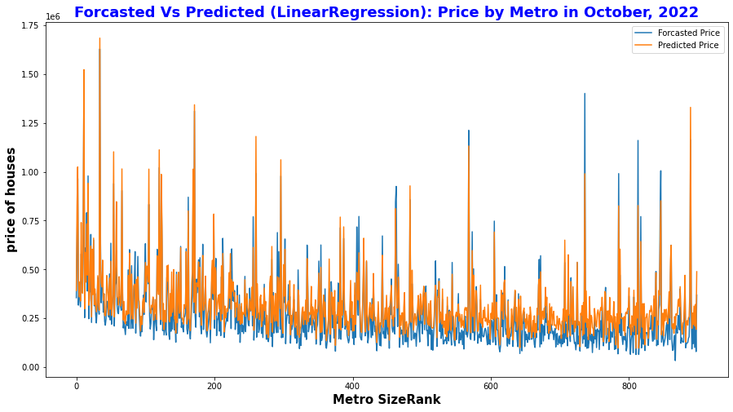
Results (Testing)
Figure 16: Predicted vs. Original house price on October 2022

Slide 18
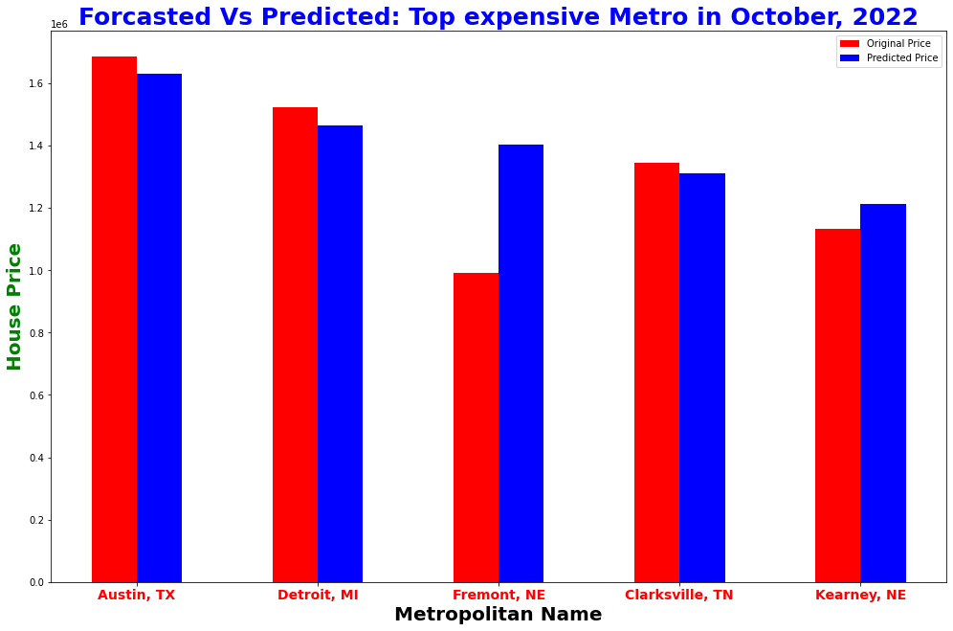
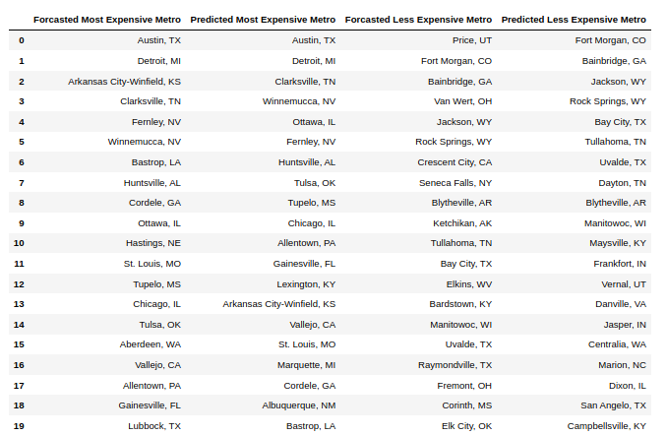
Results (Testing)
Figure 17: Top 5 metro house price on October, 2022
Figure 18: List of Top20 metro name from prediction and forecasting

Slide 19
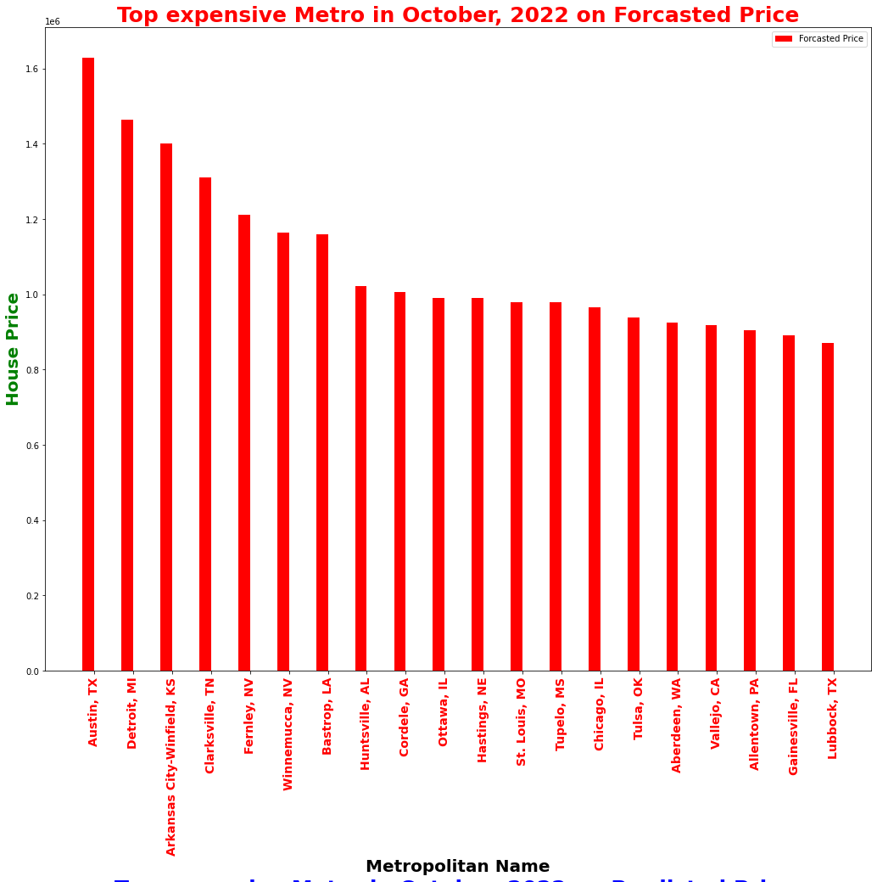
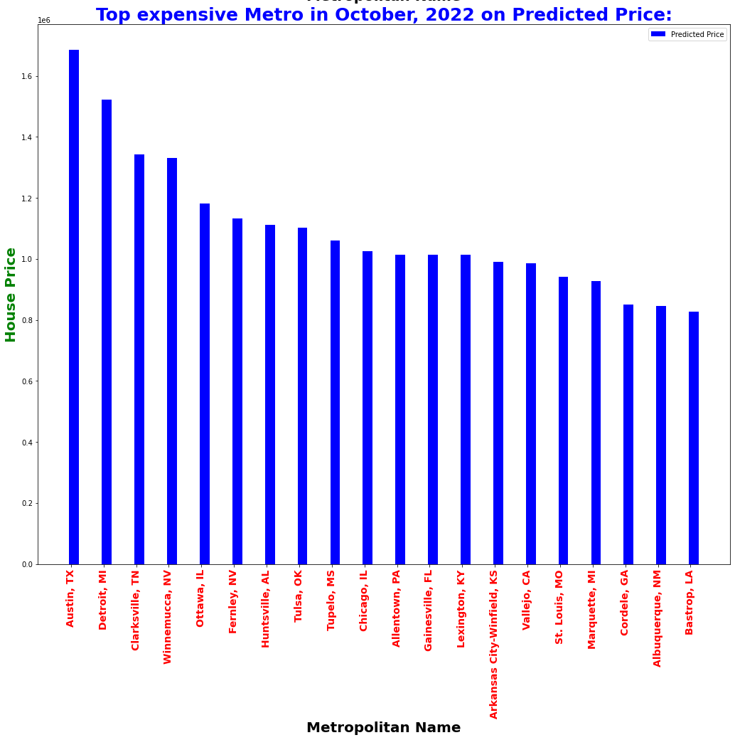
Results (Testing)

Slide 20
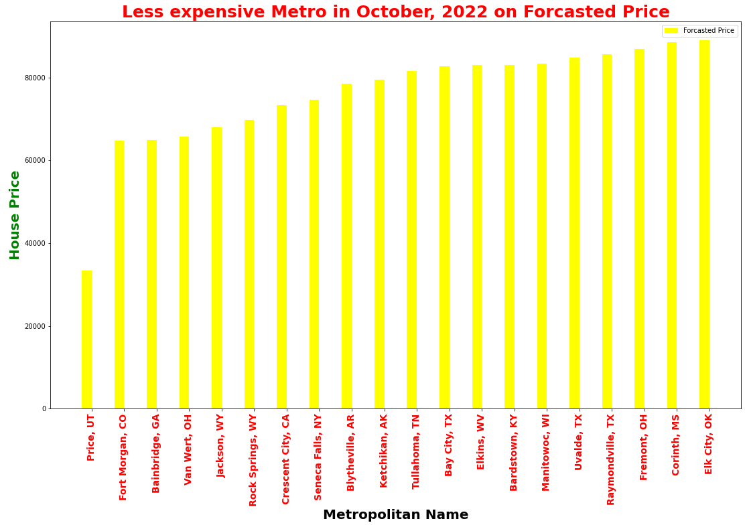
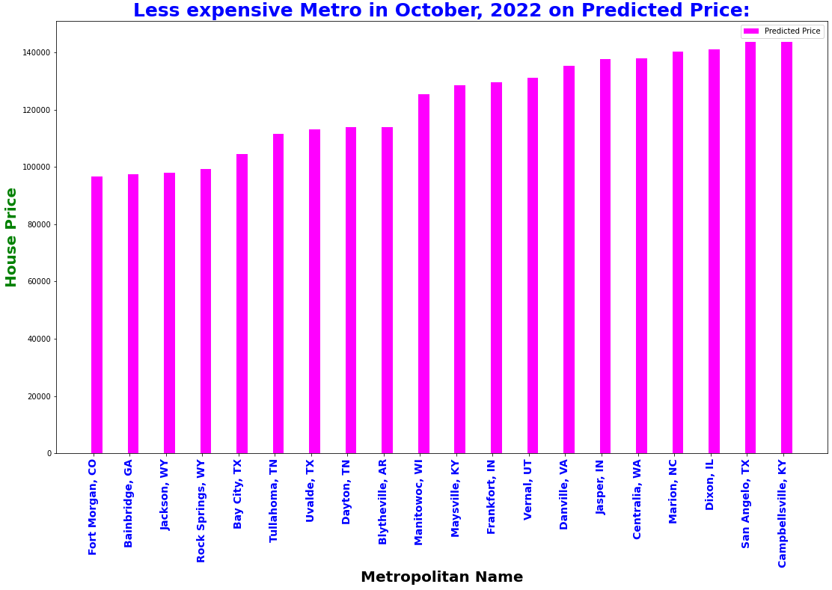
Results (Testing)

Slide 21
Lessons learned
To develop a Linear model for any prediction
Data preprocessing and preparing for model fitting
Data visualization in different aspects
Various data mining techniques

Slide 22
CHALLENGES AND FUTURE PLAN
Accuracy is only 45% for 1st model. We want to increase it.
Accuracy for 2nd model is above 99%. However, testing accuracy is not good. We want to develop a strategy to figure out it.
We will work for best suggestion for people with reasonable price and excellency on other factors

Slide 23


Slide 24
References
[1] “Housing data,” Zillow Research, 25-Mar-2021. [Online]. Available: https://www.zillow.com/research/data/. [Accessed: 14-Sep-2021].
[2] N. Bhagat, A. Mohokar, and S. Mane, “House price forecasting using data mining,” International Journal of Computer Applications, vol. 152, no. 2, pp. 23–26, 2016.
[3] V. Valkov, “Predicting house prices with linear Regression: Machine learning from SCRATCH (PART II),” Medium, 05-Jul-2019. [Online]. Available:
https://towardsdatascience.com/predicting-house-prices-with-linear-regression-machine-learning-from-scratch-part-ii-47a0238aeac1. [Accessed: 14-Sep-2021].
[5] T. Gupta, “Data preprocessing in Python,”Medium, 25-Dec-2020. [Online]. Available: https://towardsdatascience.com/data-preprocessing-in-python-b52b652e37d5.
[Accessed: 14-Sep-2021].
[6] Online source. Link: https://github.com/jaskirat111/Housing-Price-Prediction-using-Advanced-ML-Algorithms
[7] Truong, Q., Nguyen, M., Dang, H., & Mei, B. (2020). Housing price prediction via improved machine learning techniques. Procedia Computer Science, 174, 433-442.

